Slide 1
Draft FMP Priorities For Discussion
Facilities Committee
3/5/13

Slide 2
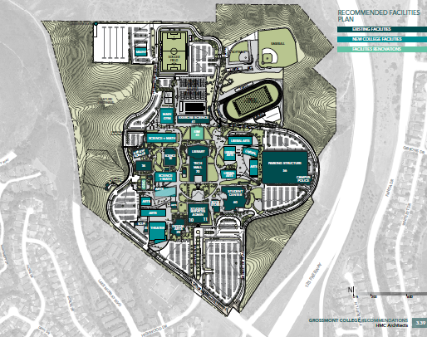
Facilities Master Plan Map

Slide 3
Grossmont College Project Summary
New Construction
 | The 200's-Arts & Communication Complex Replacement
 | - | Theater (600 seats)
 | - | Remaining classrooms & Labs submitted as part of IPP
 | The 300's - Science, Math & Career Tech Complex Replacement
 | The 500's - Liberal Arts/Business & Technology Complex Replacement
 | Exercise Science & Wellness (Main Gym)
Renovation & Repurposing
 | ESW & Athletics Teaching Facility ( Main Gym renovation, classroom)
 | Child Development Center
Site Improvements
 | Road & Parking Improvements
 | Additional Parking
 | Pool Improvements
 | Modernize Permanent Seating & Site Improvements for ESW/Athletics
 | Campus wide Landscape Improvements
 | Water Conservation, Hardscape & Landscape Improvements
 | Safety & Stabilization of Nature Preserve

Slide 4
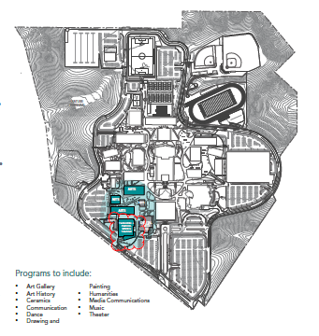
Draft Priority #1 - Theater
College had already identified this as our next project, completed FPP
Program currently without an appropriate space
Provide permanent space for temporary building removal
Would provide a large venue for events, performances, meetings

Slide 5
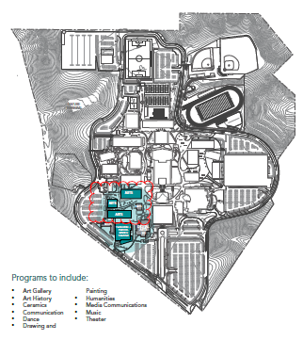
Priority 2 – 200 Complex
College had already submitted FPP and prioritized this.
Replace aging facilities
Safety Issues
Provide permanent space for temporary building removal
Submitted IPP for state matching funds
Next logical progression for construction after theater, consolidate area impact

Slide 6
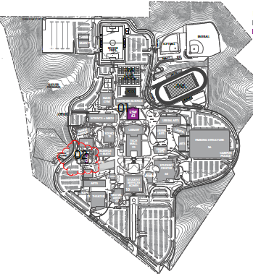
Priority – 3 Renovate Child Development Center
Remove safety hazards
Provide permanent space for temporary building removal
Finalize appropriate location for facilities
Upgrade outdoor learning area to meet current code requirements
Compact construction areas, utilize existing staging areas

Slide 7
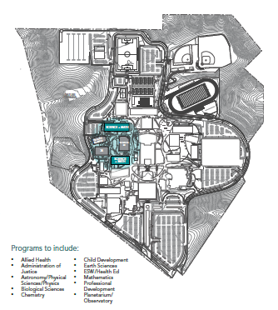
Priority -4 Replace Building 31 & 36
Replace aging facilities
Increased instructional space needs
Allow college to reclaim space in Building 36 that is currently unused but on inventory
Provide permanent space for temporary building removal
Save funds expended on temporary building lease
Smaller project than 500’s
Not currently submitted for state match

Slide 8
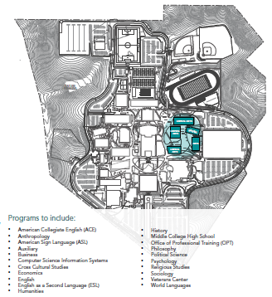
Priority -5 Replace 500’s Complex Buildings
Replace aging facilities
Increased instruction space needs
Provide permanent space for temporary building removal
Larger project will take more time to design than 500’s
Submitted IPP for state matching funds

Slide 9
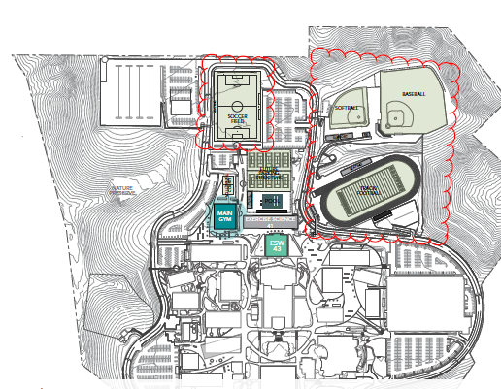
Priority – 6 ESW/Athletics Site Improvements
Provide required accessibility
Provide permanent seating and facilities
Reduce costs from bleacher and portable restroom facilities
Improve sustainability
Revenue generation /Community Connections

Slide 10
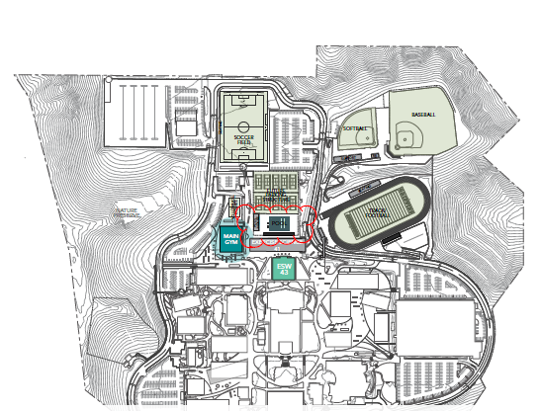
Priority – 7 Pool Improvements
Provide accessible pool space
Provide appropriate space for athletic team needs
Reduce costs of pool rentals
Improve sustainability
Revenue generation /Community Connections

Slide 11
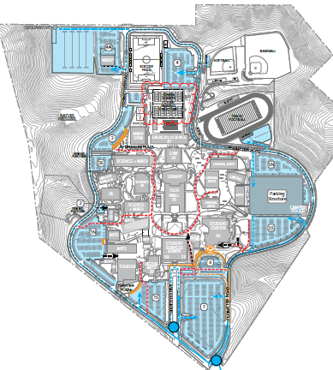
Priority 8 Additional Parking
Build new parking structure prior to loosing parking for new gym construction
Increase parking spaces for growth
Replace cracked tennis court surfaces to meet instruction and athletics needs

Slide 12
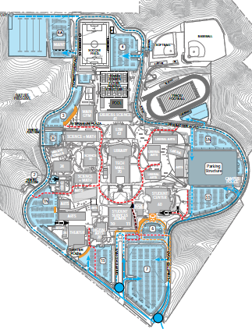
Priority – 9 Road and Parking Improvements
Remove safety hazards
Maintain accessibility
Wait until after major pool construction & parking structure dirt export
Maintain usability of parking lots
Must be done with Prop V or Parking Funds, no UGF

Slide 13
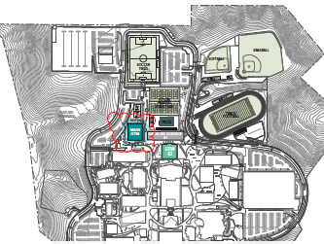
Priority – 10 New Main Gym for ESW/Athletics
Improve way finding
Provide appropriate space for ESW/Athletics needs
Improve sustainability
Revenue generation /Community connections
Improve instructional space

Slide 14
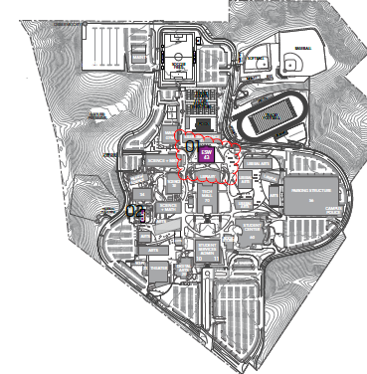
Priority - 11
Wait until new gym was built before repurposing old gym
Provide appropriate space for ESW/Athletics needs
Improve sustainability
Revenue generation /Community Connections
Improve instructional space

Slide 15
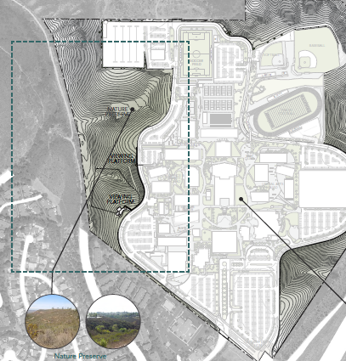
Priority – 12 Safety & Stabilization of Nature Preserve
Remove health and safety issues
Create safe accessible pathways and view points
Create observation areas out of traffic
Improve sustainability of preserve

Slide 16
Priority – 13 Water Conservation and Hardscape/Landscape Improvements
Improve accessibility to all campus facilities
Improve safety
Reduce utility costs
Support regional water quality

Slide 17
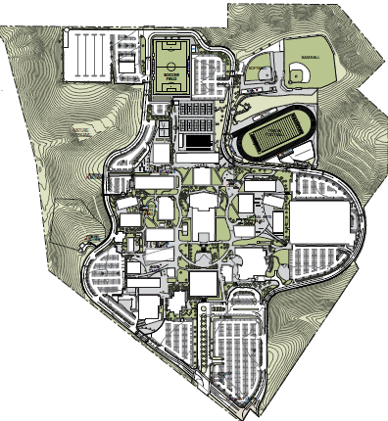
Priority – 14 Campus wide Landscape
Improve campus sustainability
Reduce impact to surrounding vegetation
Create informal learning areas

Slide 18
Grossmont College Facilities Committee Priority Summary
New Construction |  |  |  |  |  |  |  | Draft Priority
 | The 200's-Arts & Communication Complex Replacement
 | - | Theater (600 seats) |  |  |  |  |  | 1
 | - | Remaining classrooms & Labs submitted as part of IPP |  |  |  |  |  | 2
 | The 300's - Science, Math & Career Tech Complex Replacement |  |  |  |  |  |  | 4
 | The 500's - Liberal Arts/Business & Technology Complex Replacement |  |  |  |  |  |  | 5
 | Exercise Science & Wellness (Main Gym) |  |  |  |  |  |  | 10
Renovation & Repurposing
 | ESW & Athletics Teaching Facility ( Main Gym renovation, classroom) |  |  |  |  |  |  | 11
 | Child Development Center |  |  |  |  |  |  | 3
Site Improvements
 | Road & Parking Improvements |  |  |  |  |  |  | 9
 | Additional Parking |  |  |  |  |  |  | 8
 | Pool Improvements |  |  |  |  |  |  | 7
 | Modernize Permanent Seating & Site Improvements for ESW/Athletics |  |  |  |  |  |  | 6
 | Campus wide Landscape Improvements |  |  |  |  |  |  | 14
 | Water Conservation, Hardscape & Landscape Improvements |  |  |  |  |  |  | 13
 | Safety & Stabilization of Nature Preserve |  |  |  |  |  |  | 12

Slide 19
Project Sequencing/Phasing
Final phasing of the projects will be contingent upon:
Prop “V” bond series
Voter approval of California state Facilities Bonds
Infrastructure needs
Realistic and cost effective sequencing that most optimally ensures continuity of services

Slide 20
Discussion & Questions

